Slide 1
Activity Diagrams

Slide 2
Activity Diagrams
Use cases show what your system should do.
Activity diagrams allow you to specify how your system will accomplish its use cases.
Dynamically shows how process of activities are executed

Slide 3
Elements of an Activity Diagram
Actions and activities
Object Nodes
Control Flows and Object Flows
Control Nodes
Initial activity,
final-activity,
final-flow,
decision,
merge,
fork, and join
Swimlanes

Slide 4
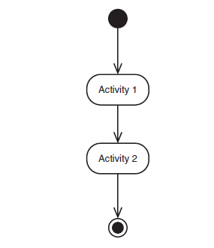
Activity Diagram: Basic Conventions
A rounded rectangle shows an activity.
An arrow represents the transition from an activity to another.
Starting point represented by a filled circle and an ending point represented by a bull’s eye .

Slide 5
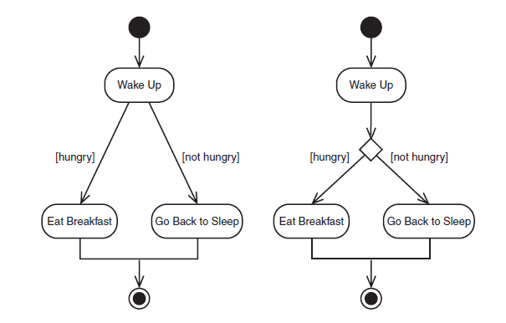
Decisions in Activity Diagrams
One set of conditions leads to one path, another set of conditions leads to another path and the two paths are mutually exclusive.
Decisions can be represented in two ways
Possible paths coming directly from an activity
Activity transitions into a small diamond from where possible paths flow.

Slide 6
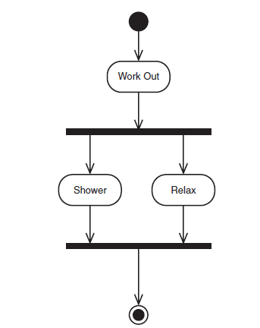
Concurrent Paths
Sometimes a transition needs to be separated into two paths that runs concurrently and then come together again.
The split of transition in two paths is represented a solid bold line drawn perpendicular to the transition.
The paths are shown as coming out of the line.
For merge, the paths will point at another solid bold line.

Slide 7
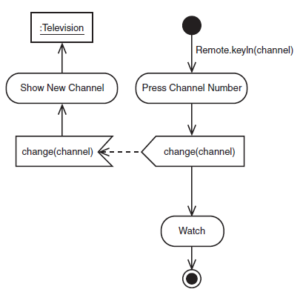
Sending/Receiving Signals
During the sequence of activities it is possible to send a signal. The symbol for sending a signal is a convex polygon (an output event in UML) .
The signal when received, causes an activity to take place. This received signal is shown by a concave polygon (an input event in UML).

Slide 8
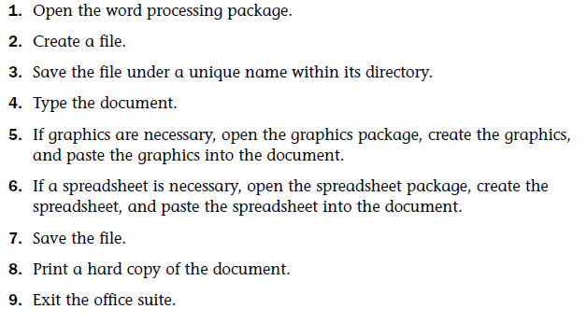
Example: A process (Creating a Document)
Sequence of activities required for using an office suit to create a document.

Slide 9
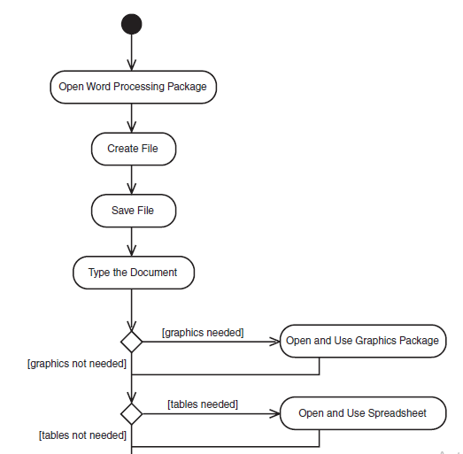
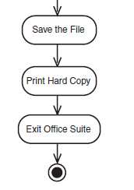
Example: A process (Creating a Document)

Slide 10
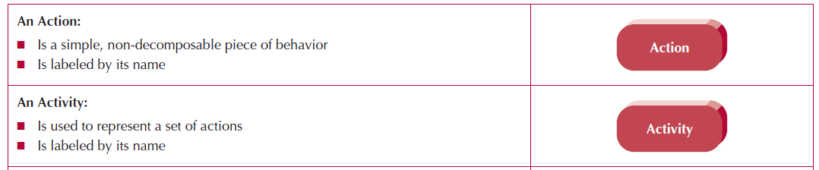
Actions and Activities
Actions and activities are performed for some specific business reason.
Actions and activities can represent manual or computerized behavior.
They are depicted in an activity diagram as a rounded rectangle.
Furthermore, they should have a name that begins with a verb and ends with a noun (e.g., “Make Appointment” or “Make Payment Arrangements”).

Slide 11
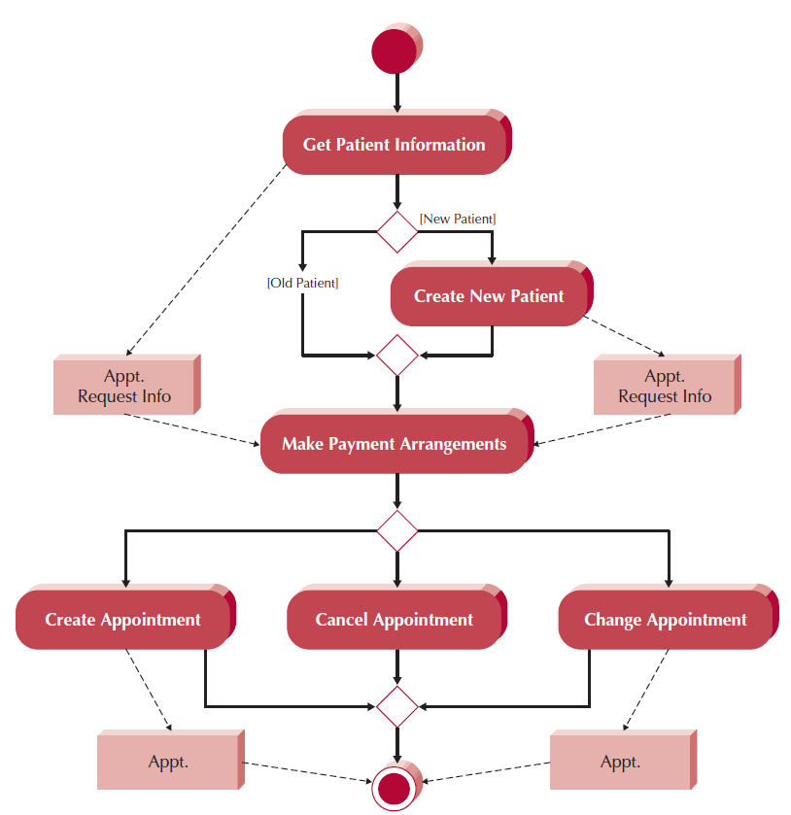
Actions and Activities
The only difference between an action and an activity is that an activity can be decomposed further into a set of activities and/or actions, whereas an action represents a simple non-decomposable piece of the overall behavior being modeled.
Furthermore, in most cases, each activity will be associated with a use case.
The activity diagram in Figure shows six separate but related activities for a typical appointment system used in a doctor’s office.

Slide 12
Control Nodes
There are seven different types of control nodes in an activity diagram:
initial,
final-activity,
final-flow,
decision,
merge,
fork, and
join

Slide 13
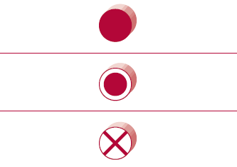
Control Nodes
An initial node portrays the beginning of a set of actions or activities.
An initial node is shown as a small filled in circle.
A final-activity node is used to “stop the process” being modeled. Any time a final-activity node is reached, all actions and activities are ended immediately, regardless of whether they are completed.
A final-activity node is represented as a circle surrounding a small filled-in circle making it resemble a bull’s eye.
A final-flow node is similar to a final-activity node, except that it stops a specific path of execution through the business process, but allows the other concurrent or parallel paths to continue.
A final-flow node is shown as a small circle with an X in it.

Slide 14
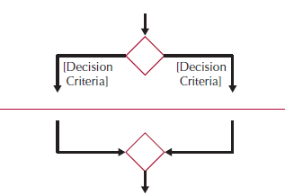
Control Nodes
The decision and merge nodes support modeling the decision structure of a business process.
The decision node is used to represent the actual test condition that is used to determine which of the paths exiting the decision node is to be traversed. In this case, each of the exiting paths must be labeled with a guard condition.
The merge node is used to bring back together multiple mutually exclusive paths that have been split based on an earlier decision.

Slide 15


Control Nodes
The fork and join nodes allow parallel and concurrent processes to be modeled
The fork node is used to split the behavior of the business process into multiple parallel or concurrent flows.
Unlike the decision node, the paths are not mutually exclusive (i.e., both paths are executed concurrently).
For example, the fork node is used to show that two concurrent, parallel processes are to be executed.
However, the purpose of the join node is similar to the merge node.
The join node simply brings back together the separate parallel or concurrent flows in the business process into a single flow.

Slide 16
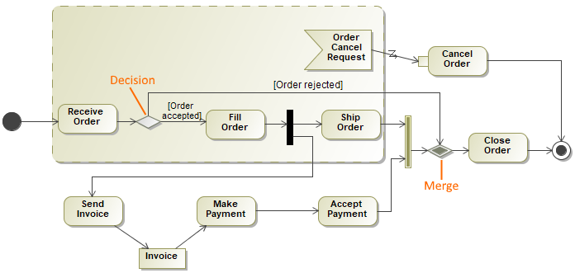
Pizza order

Slide 17
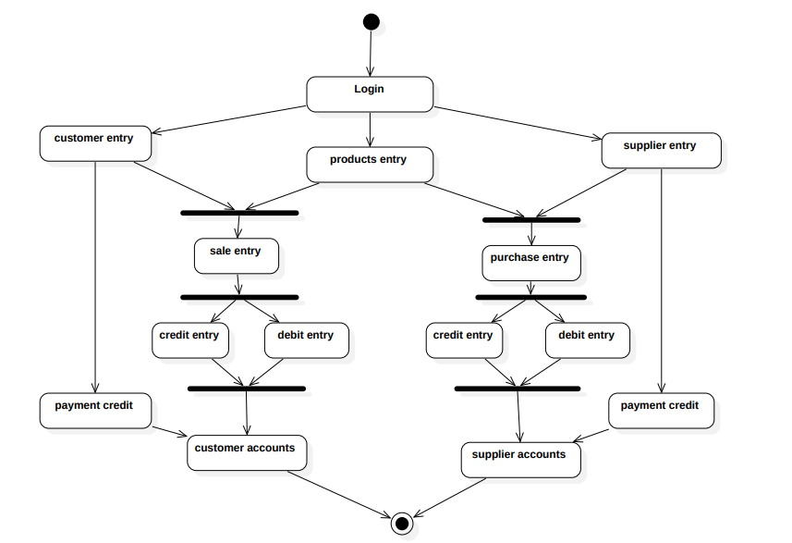
Activity diagram for point of sale

